Slide 1
AI-Powered-Enhanced EHR Imaging & Documentation System Milestone: 2 Medical Imaging Enhancement Team Name: TEAM-B

Slide 2
agenda
1. Use GenAI to enhance image quality and support diagnosis
2. Apply GenAI for denoising and realistic reconstruction of medical images 3. Support better visualization for clinicians by improving image resolution and clarity 4. Train image enhancement models using Azure OpenAI tools

Slide 3
PROBLEM STATEMENT Many EHR images suffer from low resolution, noise, and poor visual quality, which can lead to reduced diagnostic accuracy and unreliable AI model training. These image limitations make it difficult for clinical systems to extract accurate information and for AI models to learn effectively from medical data.

Slide 4
Proposed Solution / Architecture Overview
Our proposed system enhances medical imaging quality using AI-powered super-resolution techniques to improve diagnostic accuracy and clarity.
The workflow begins by accessing preprocessed medical images from Milestone 1 and loading their corresponding metadata for traceability.
These images are then passed through the Real-ESRGAN model, which intelligently restores details, removes blur and noise, and produces high-resolution versions.
Finally, enhanced images are stored in structured folders for further analysis and evaluation.

Slide 5
TOOLS & TECHNOLOGIES USED
1. Python : Core programming language for implementation and automation.
2. Google Colab : Cloud-based environment for running and testing models efficiently.
3. PyTorch : Deep learning framework used to support the Real-ESRGAN model.
4. Real-ESRGAN : AI-based super-resolution model used for enhancing X-ray image quality.
5. OpenCV : Used for image loading, manipulation, and visualization.
6. PIL (Python Imaging Library) : For image conversion and preprocessing tasks.
7. Matplotlib : For displaying image outputs and comparison visuals.

Slide 6
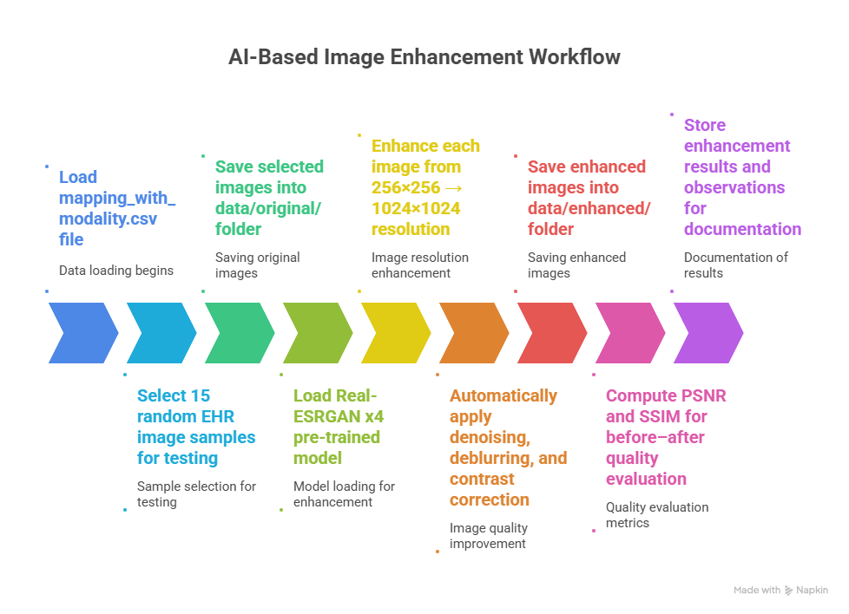
implementation PROGRESS

Slide 7
TECHNICAL CHALLENGES & SOLUTIONS
basicsr + NumPy 2.0 crash The incompatibility between the basicsr library and NumPy 2.0 caused frequent runtime errors. To resolve this, we manually rebuilt the RRDBNet architecture entirely in pure PyTorch, ensuring stable execution.
2. params_ema key error in .pth Loading pretrained ESRGAN weights raised a missing key error for params_ema. We fixed this by explicitly extracting weights using torch.load(...)[‘params_ema’], restoring correct model initialization.

Slide 8
LEARNINGS & SOLUTIONS
Handling Model & Library Conflicts:
Resolved compatibility issues between NumPy 2.0 and basicsr by rebuilding RRDBNet directly in PyTorch. This improved control over the enhancement pipeline and ensured stable execution.
Mastery of Super-Resolution Techniques:
Gained deeper understanding of Real-ESRGAN x4 architecture and its role in enhancing low-quality EHR images.

Slide 9
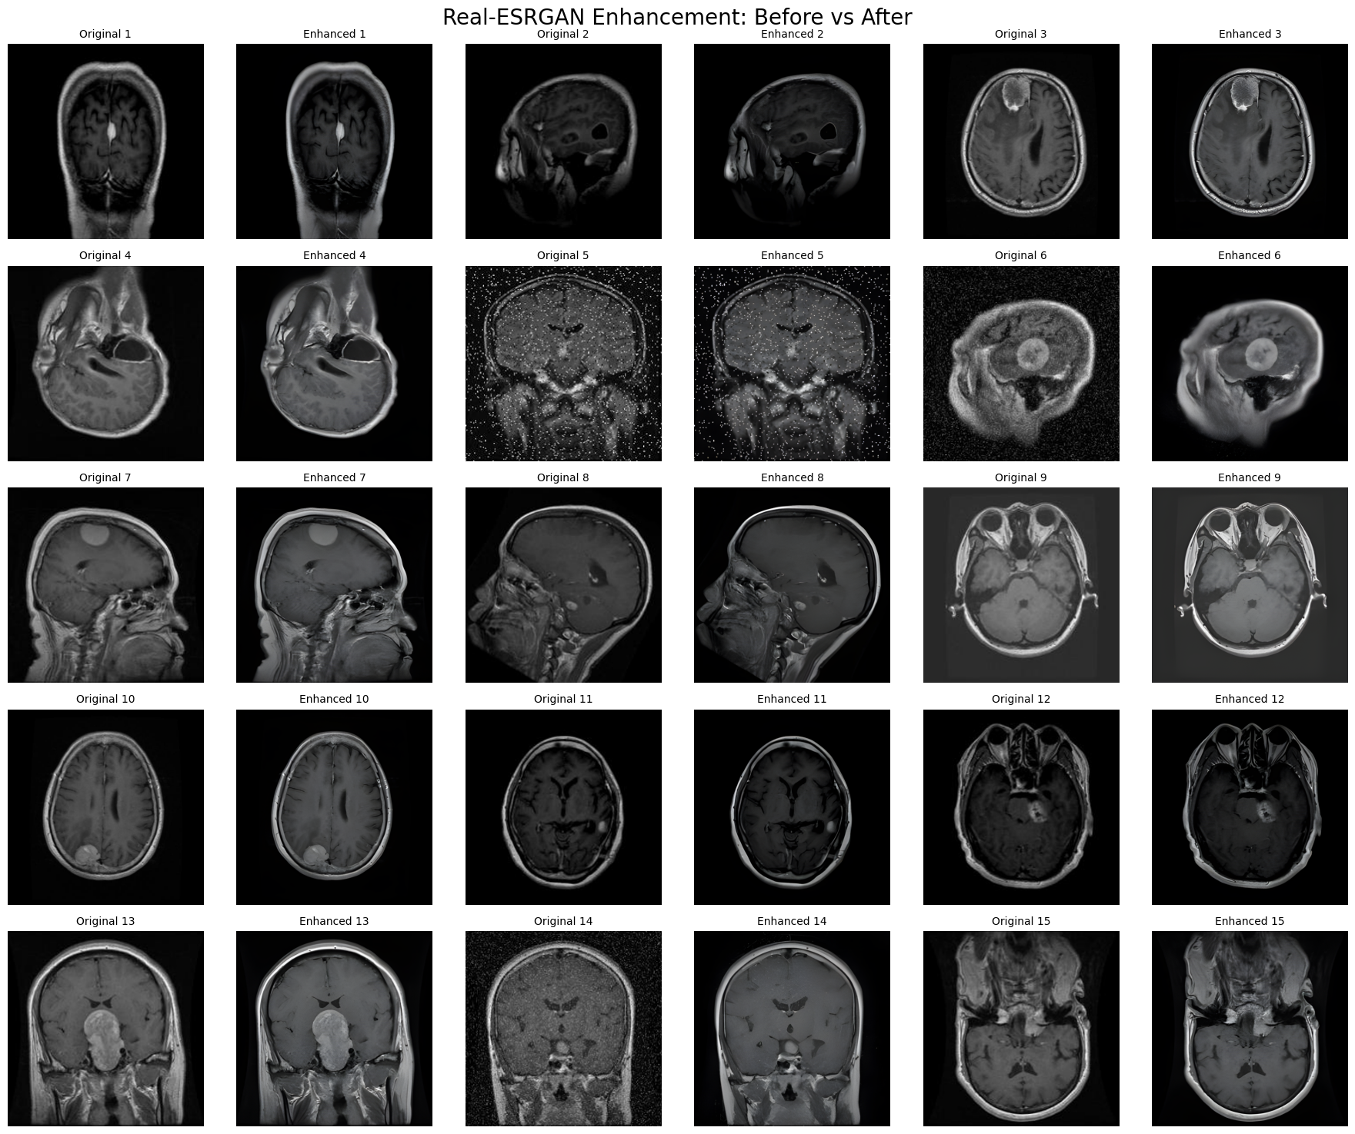
results

Slide 10
NEXT Steps
With image enhancement completed, the next phase focuses on automating clinical documentation and diagnosis coding using GenAI-driven clinical note generation and ICD-10 mapping.
Following this, we will integrate and deploy all modules into real-time hospital EHR systems, ensuring smooth interoperability and hands-on training for medical staff.

Slide 11
Thank you
Team B Members: Pushpa Latha
Nikshitha Naradasu
Shaik Afreen Hasen
Saniha Manjunath
Gaurav Subhash Borse
Tejasri Nakka
Deepana
Pranjali Jadhav
Vignesh M J
Priyanshi
Sanjana

